Slide 1
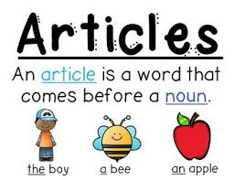

Slide 2
Review of Previous Class
Vowels are …..

Slide 3
What is Indefinite Article…..Which article we use before Indefinite
Indefinite article tells about not any particular or specific noun.
We use a or an before the noun. Example: a car, an orange etc.

Slide 4
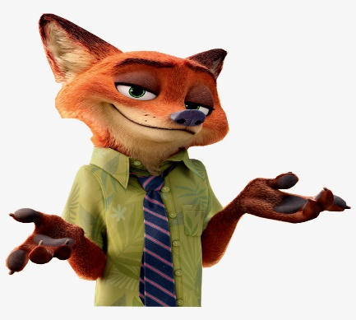
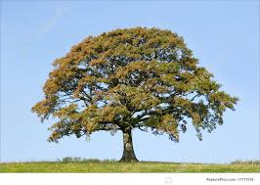
Surprise Test Put the proper article (a, an)before the words.
_____ king
_____ fox
_____ pen
______ oak tree

Slide 5
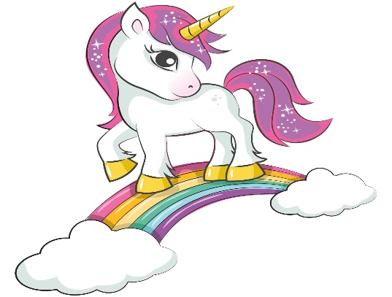
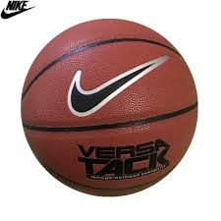
Put the proper article (a, an)before the words.
______ cow
______ unicorn
_______ ball

Slide 6
Definite Article
The definite article means clear, obvious. It tells us that the noun is specific. The speaker talks about a particular thing.
I like the red apple
I want the doll

Slide 7
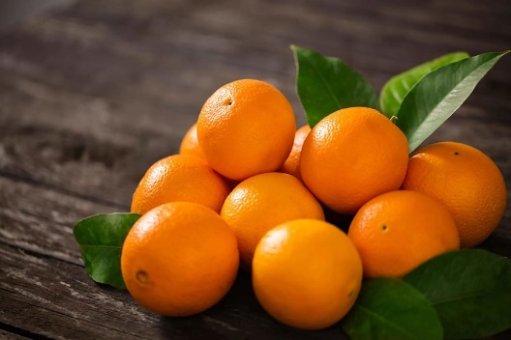
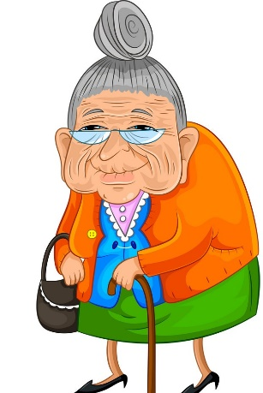
The oranges are sour.
I love the fiction books.
The old lady crossing a road.
The butter fly is blue.

Slide 8
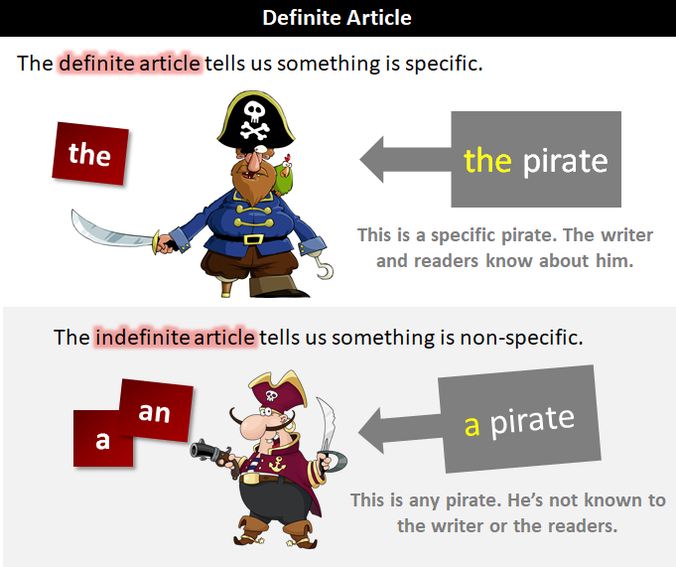
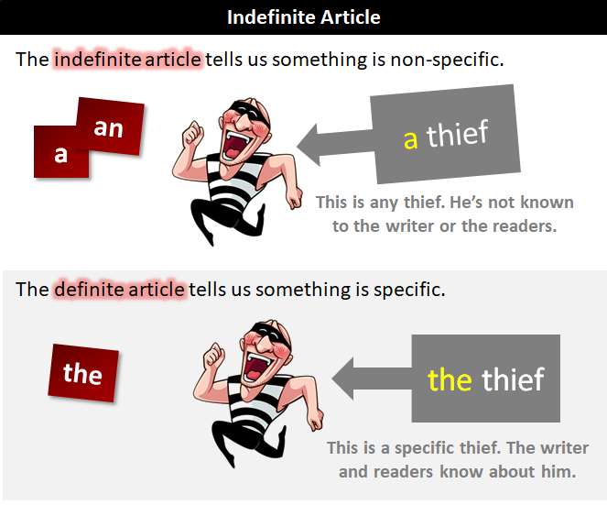

Slide 9
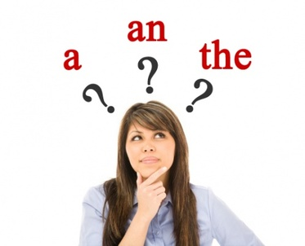

Slide 10
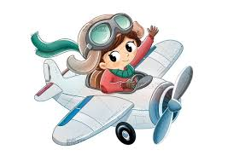
Matching
a
An
A
The
an
b
c
d

