Slide 1
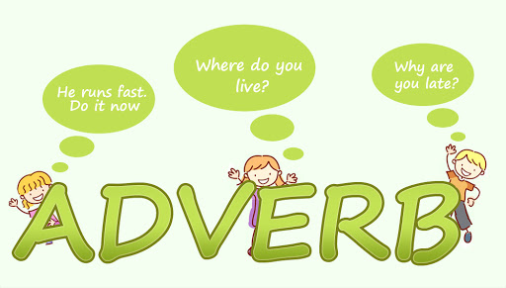
Prepared By
Afia Zahin

Slide 2
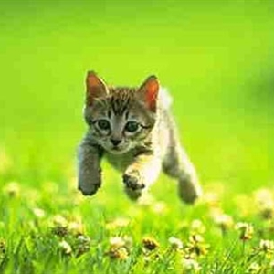
Adverbs
An adverb is a word that adds meaning to
a verb, an adjective or another adverb.
It tells when, where or how.
The cat ran _________(when/ where/ how)
today/here/ quickly.
I have to go ________ (when/where/how)
now/there/ quickly.

Slide 3
A large number of adverbs are formed from adjectives by adding – ly. Most of the “how” words end in – ly.
Example:
quickly, beautifully, quietly, slowly, really, heavily, angrily, neatly greedily, eagerly

Slide 4
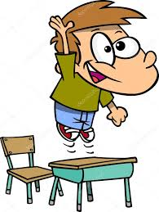
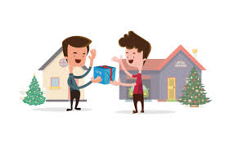
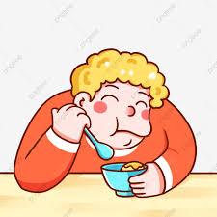
Adverbs with - ly
eagerly
Unwillingly
greedily
generously
cleanly
uncleanly
happily
angrily

Slide 5
Adverb of place | Adverb of time | Adverb of manner
Show where something is happens. | Show when something is happens. | Show how is happens.
I searched everywhere. I am going back to school. She took the child outside. | She came at around at 9:30 pm. I slept late the previous night. Now I am going to her home. | He spokes softly. He ate the chocolate greedily. He swims quickly.

Slide 6
A. Manner
A. Time
A. Place

